Slide 1

Visualizing Object Clouds Through Energy Minimization
MCSc Defence
Okesanjo Omobola
19 October 2020

Slide 2
Contents
Background
Work
Experimental Setup
Results
Conclusion
Future Work

Slide 3
Background
Overview

Slide 4
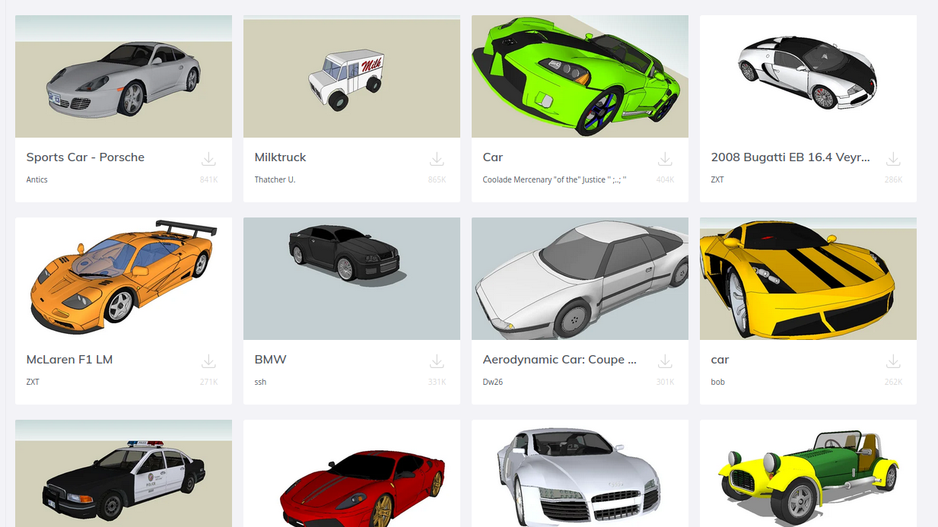
3D Object Clouds
On systems like TurboSquid & 3D Warehouse, search result of 3D CAD models are displayed as a grid of discrete rows and columns.

Slide 5
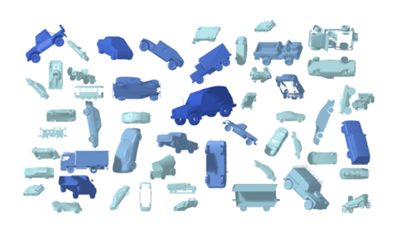
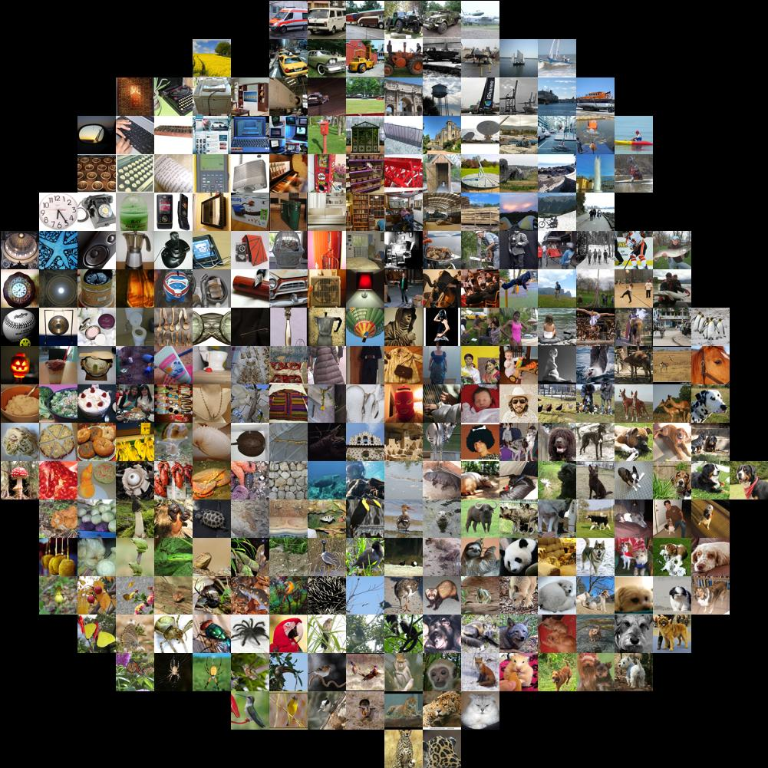
3D Object Clouds
Can search be improved if the 3D models are displayed as a cloud?

Slide 6
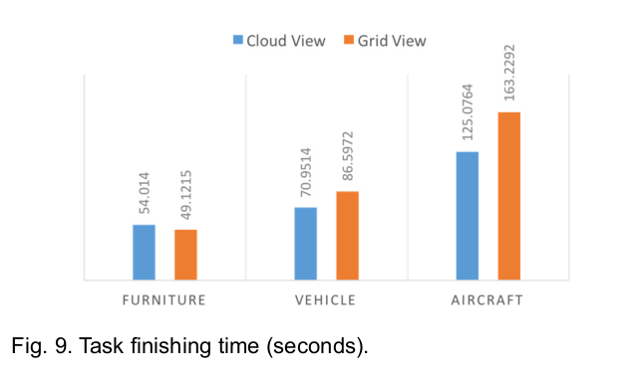
3D Object Clouds
In a study carried out by Hong and Brooks (2015), users found it faster to search for a set of target 3D models in a cloud.

Slide 7
Semantic Object Clouds
In the layout proposed by Hong and Brooks (2015) a pair of objects that are similar might be at different locations.
We can improve the search times by creating semantic object clouds.

Slide 8
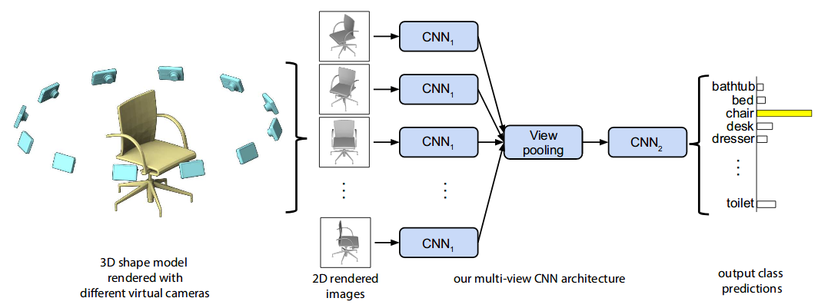
Multiview Convolutional Neural Network (MVCNN)
We start by generating vector embeddings for the objects (Su et al, 2015).

Slide 9
Multidimensional Scaling
Semantic word clouds use Multidimensional Scaling (MDS) to map an embedding to 2D locations in the cloud.
A force-directed graph is then used to refine the initial MDS layout (Cui et al, 2010).

Slide 10


Graph Drawing
Force-directed and graph-theoretic algorithms for drawing a graph do so by minimizing its energy.
A graph-theoretic algorithm like the Kamada-Kawai algorithm is a form of MDS (Gansner et al, 2004).

Slide 11
Q: Can we combine MDS and force-directed graphs into a single function for generating optimal object clouds?

Slide 12
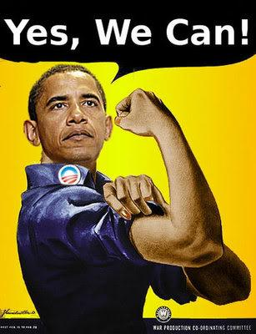

Slide 13
Work
Energy function for object clouds

Slide 14
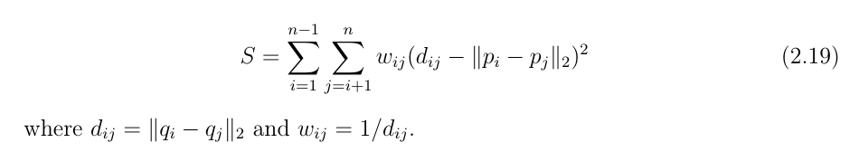

Energy Function
We can convert MDS into a force-directed algorithm
We first split the weighting into an attractive and repulsive weighting
Repulsive
Attractive

Slide 15
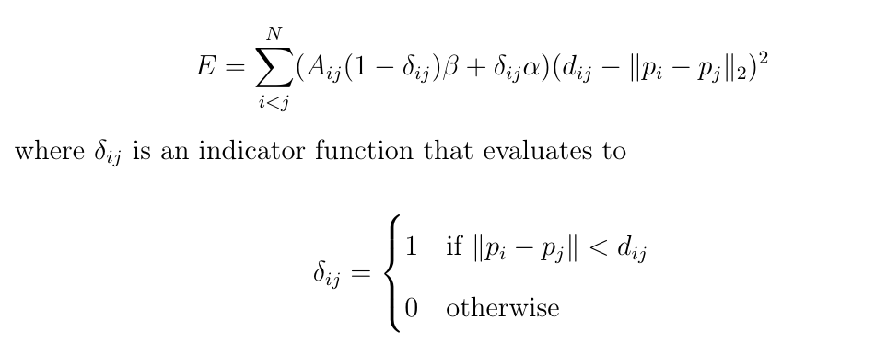
Energy Function
Graph adjacency

Slide 16
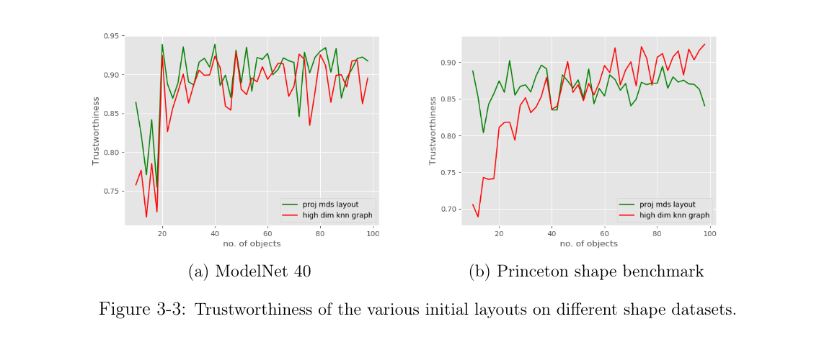
Energy Function
The energy function acts on a high-dimensional K-Nearest Neighbour (KNN) graph.

Slide 17
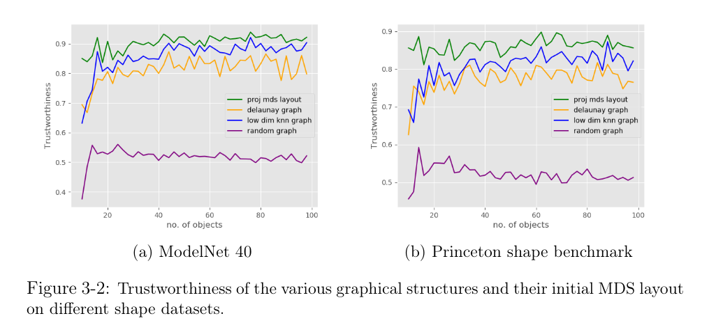
Energy Function
It is preferred in comparison to low-dimensional graphs.

Slide 18

Energy Function
We can extend the energy function to word clouds by changing the distance function so that it reflects the rectangular geometry of words.

Slide 19
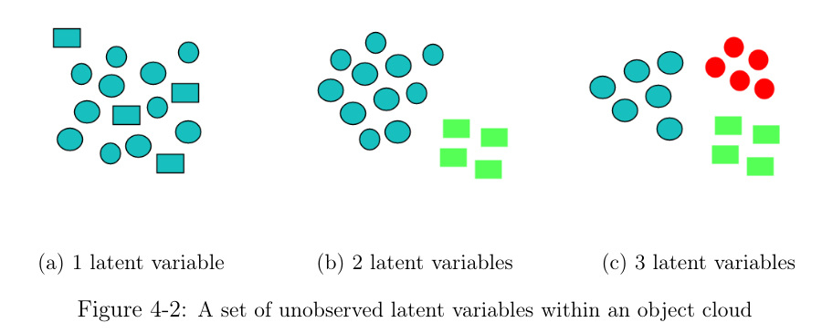
Latent Variables
Object grouping can be further improved with latent variables which are clusters.

Slide 20
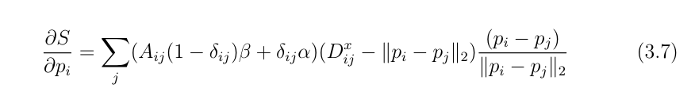
Energy Optimization
Gradient Descent: The gradient of the energy tells us what direction to move an object in order to reduce the energy.
Random Replay: We can escape some local minima by permuting the order in which objects are moved.

Slide 21
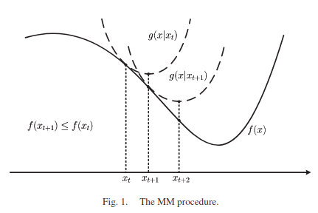
Energy Optimization
Majorize-minimization uses a surrogate function to minimize a main function.

Slide 22
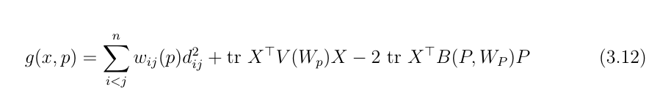
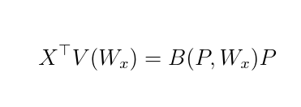
Energy Optimization
The surrogate function for our energy function is
We then solve for the input in

Slide 23
Experimental Setup
Energy function for object clouds

Slide 24
Models
We evaluated our approach against the following models.
Object cloud | Word cloud
Context preserving | Context preserving
Breadth-first search | Seam carving
 | Wordle

Slide 25
Metrics
We used the following metrics for 9, 25, 49, 81 and 100 objects:
Trustworthiness
Compactness
Realized Adjacency
Final energy

Slide 26
Datasets
For our object cloud experiments we used the Princeton Shape Benchmark and ModelNet40 datasets.
For our word cloud experiments we used the Gutenberg and Reuters datasets.

Slide 27
Results
Energy function for object clouds

Slide 28
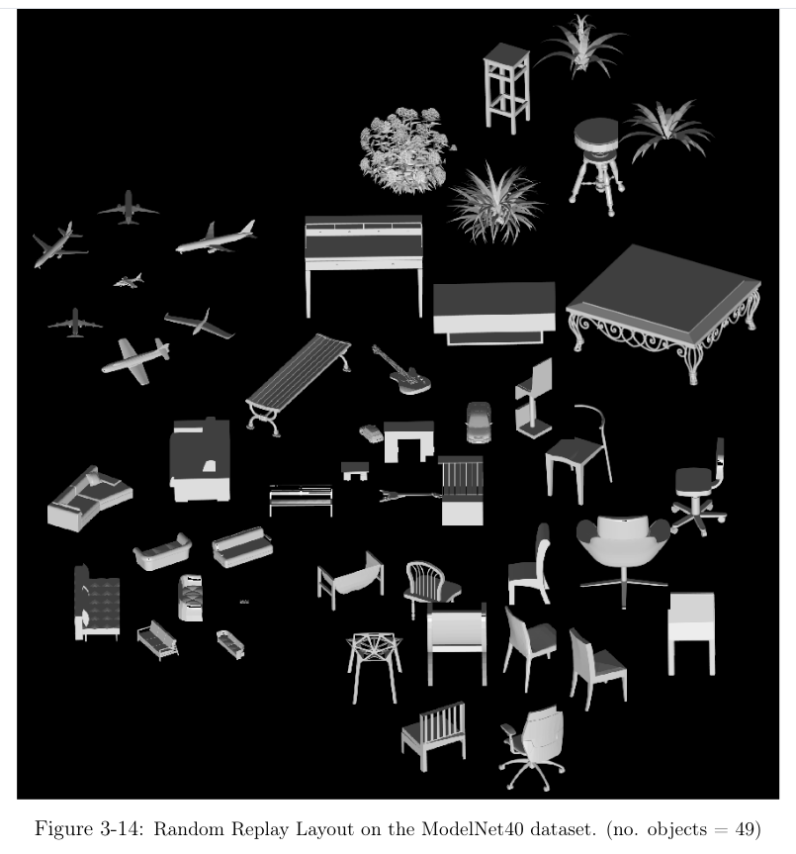
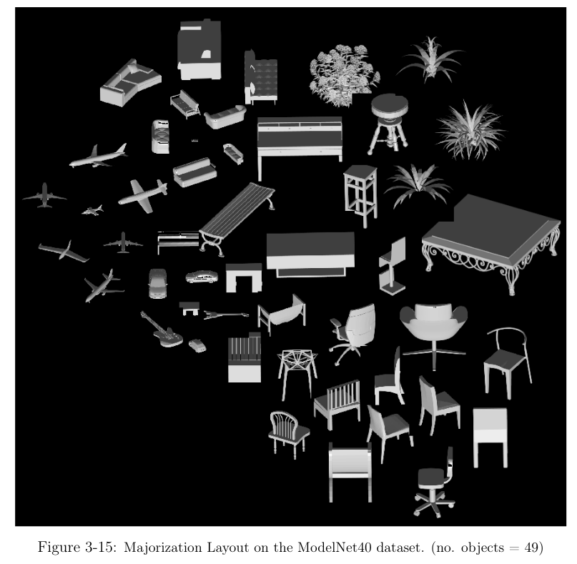
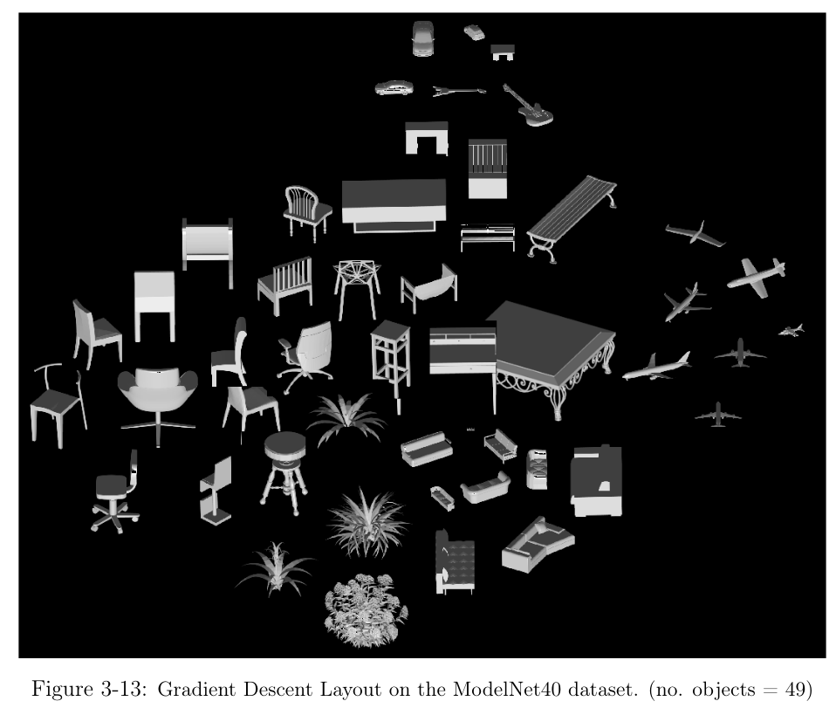
Results

Slide 29
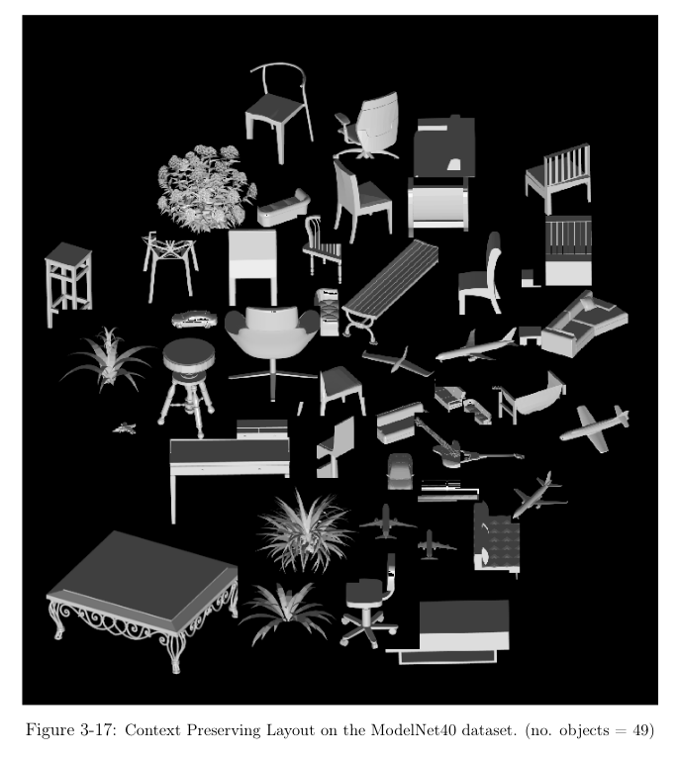
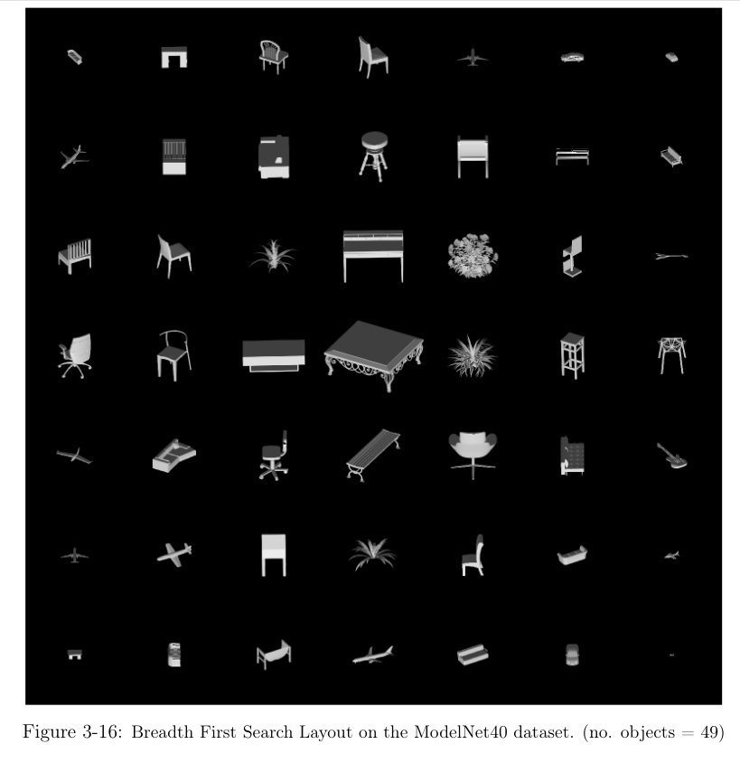
Results

Slide 30
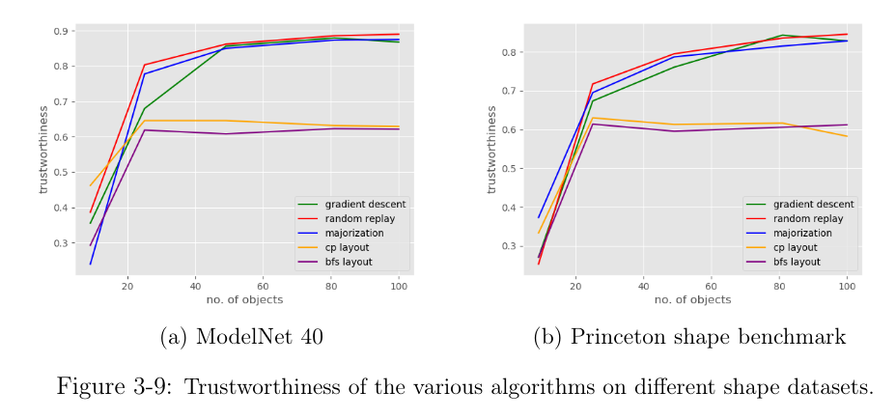
Trustworthiness

Slide 31
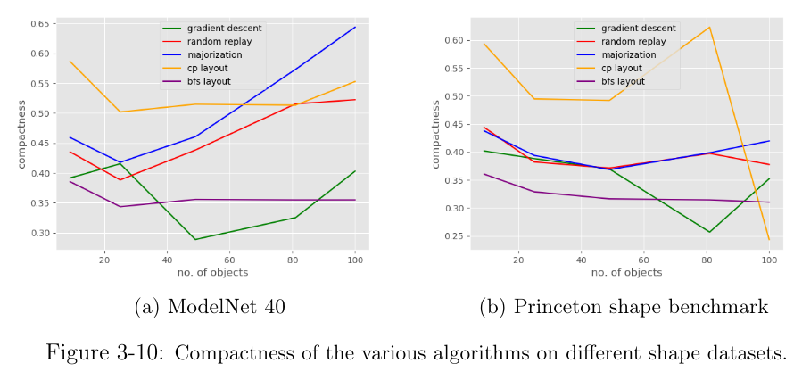
Compactness

Slide 32
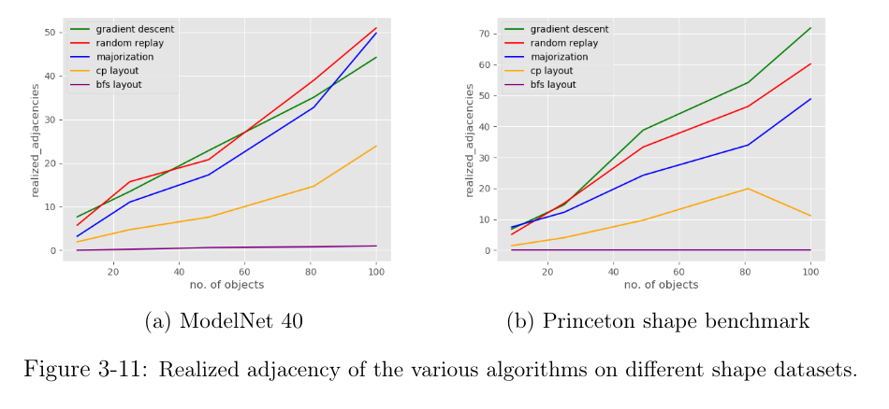
Realized Adjacency

Slide 33
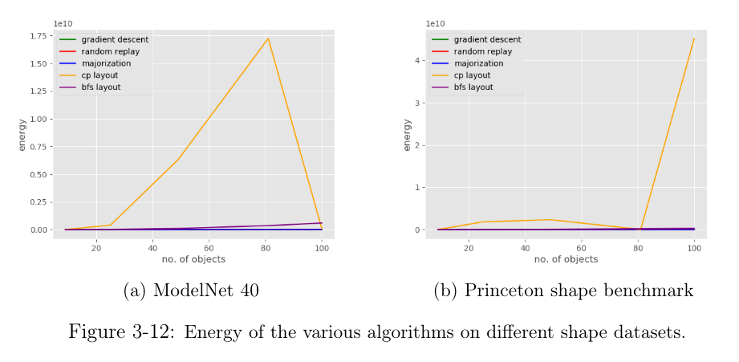
Energy

Slide 34
Results
Latent variables for object clouds

Slide 35
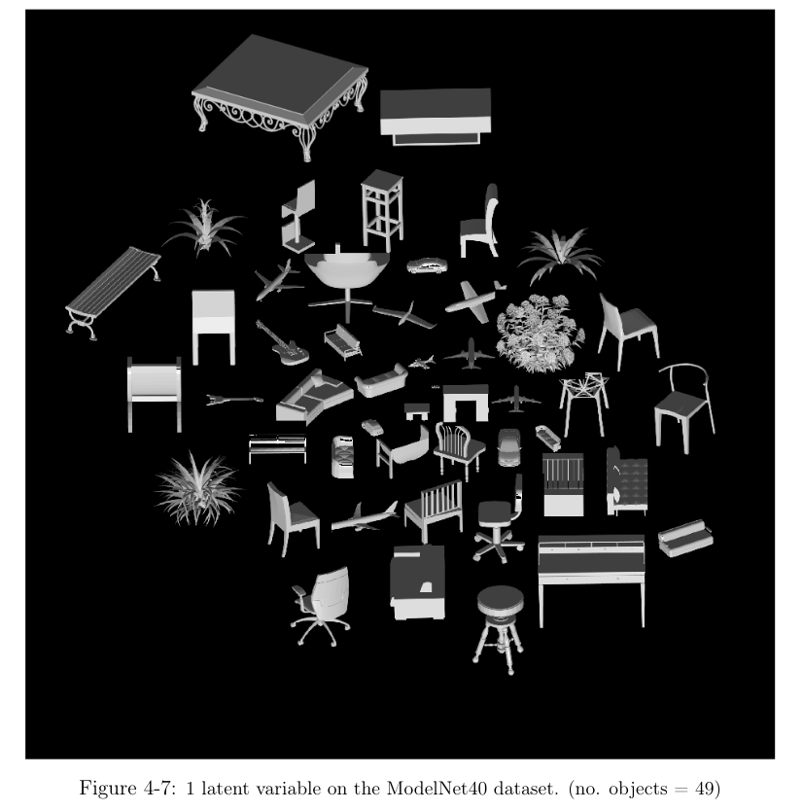
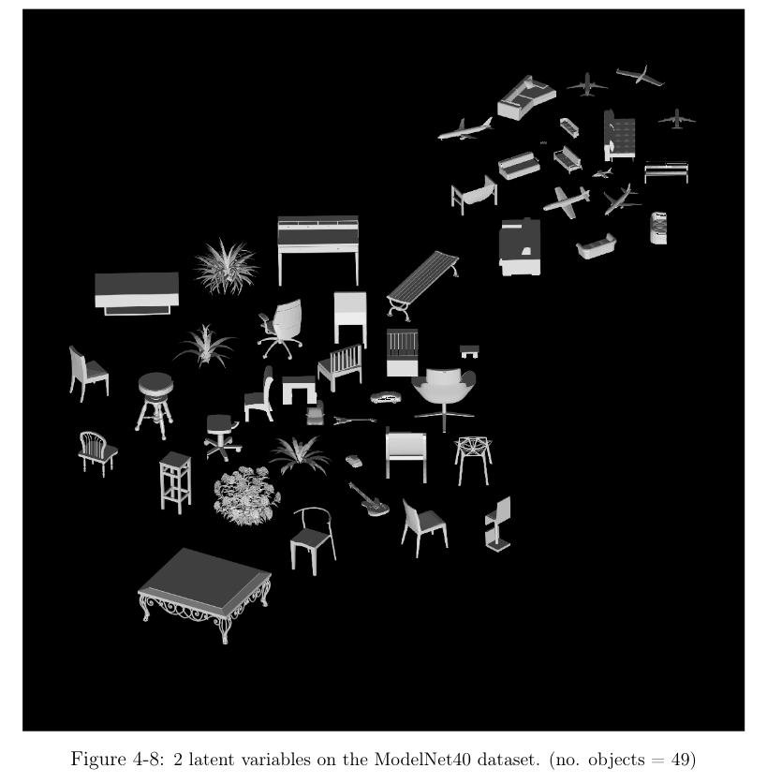
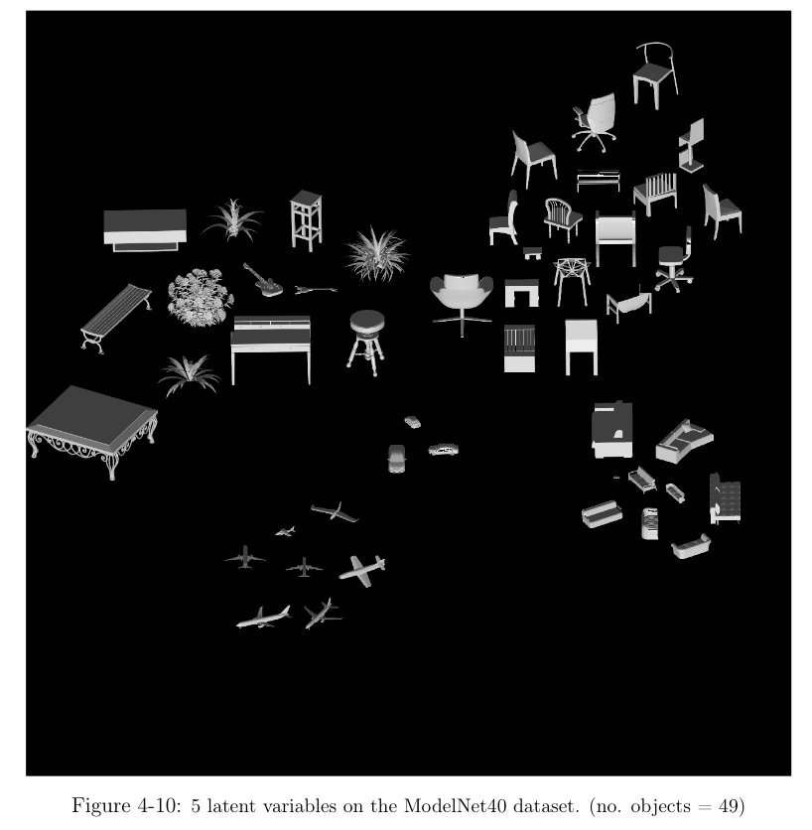
Results

Slide 36
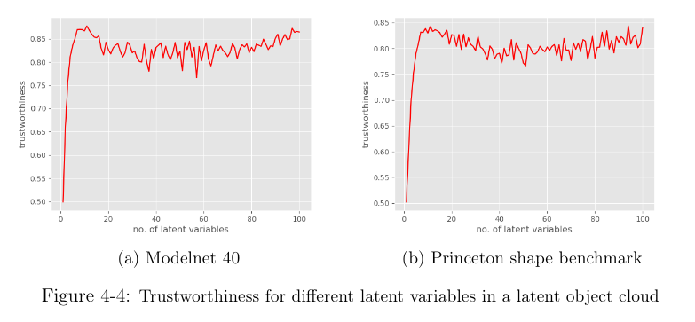
Trustworthiness

Slide 37
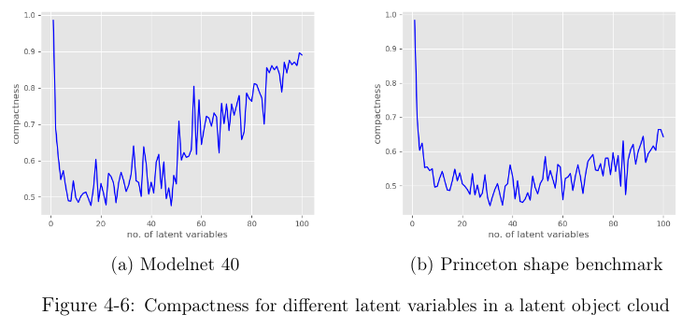
Compactness

Slide 38
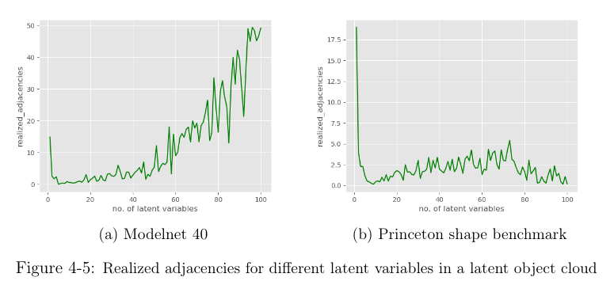
Realized Adjacency

Slide 39
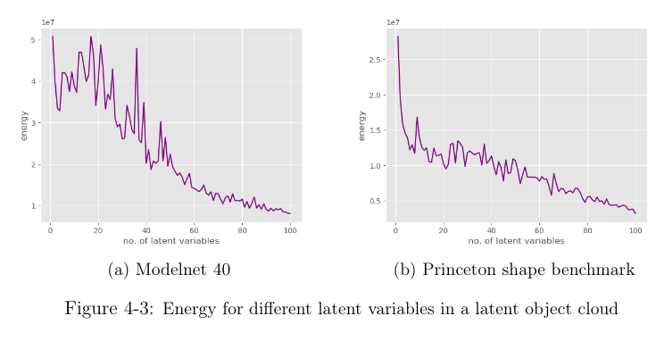
Energy

Slide 40
Results
Energy function for word clouds

Slide 41
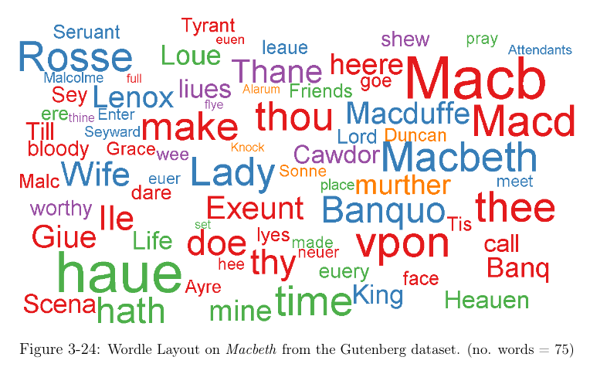
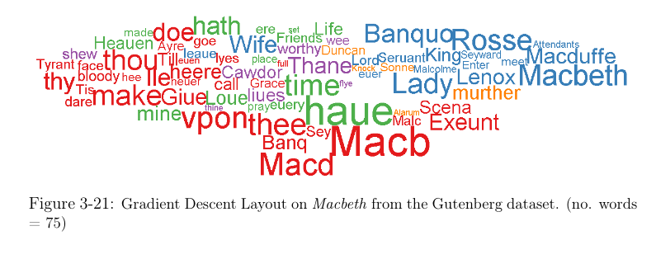
Results

Slide 42
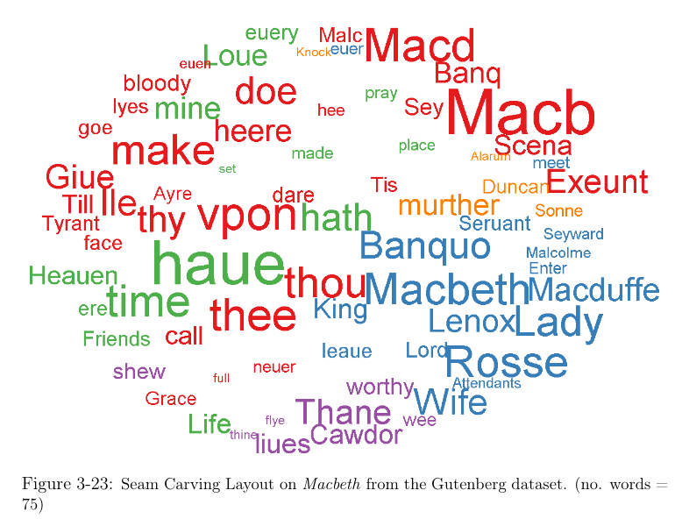
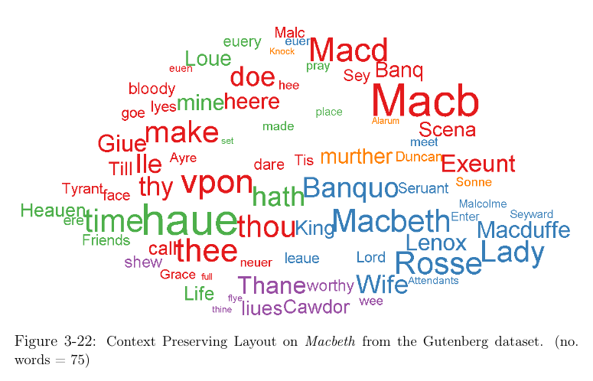
Results

Slide 43
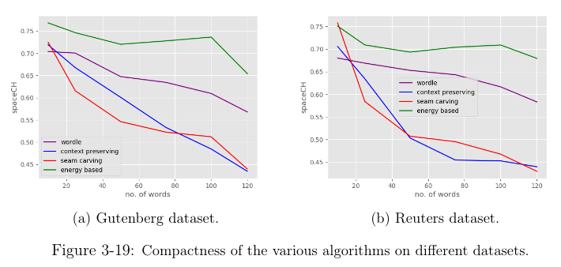
Compactness

Slide 44
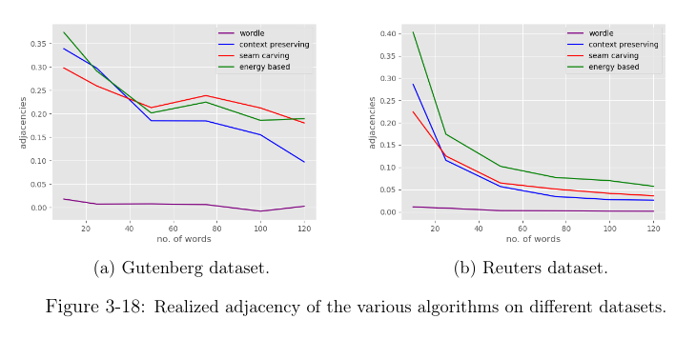
Realized Adjacency

Slide 45
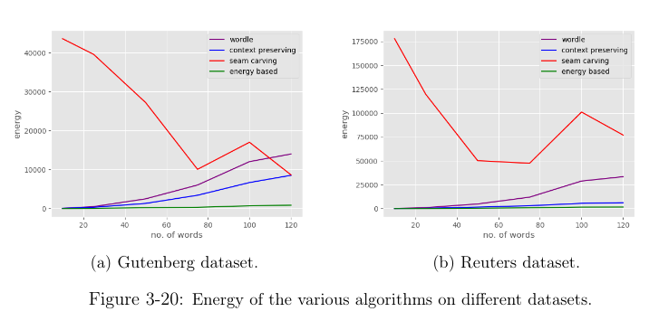
Energy

Slide 46
Conclusion

Slide 47
Conclusion
We can generate better object and word clouds using high-dimensional graphs.
Energy minimization opens the door to applying numerical optimization and machine learning methods to object and word clouds.

Slide 48
Future Work

Slide 49
Future work
A user study is needed to evaluate the efficacy of a semantic layout for visual search.
More analysis into word clouds to see if numerical optimization techniques like majorize-minimization can be suitably applied.

Slide 50
Questions?

Slide 51
References
3D Warehouse. Retrieved October 13, 2020, from https://3dwarehouse.sketchup.com/
Karpathy, A. SNE visualization of CNN codes. Retrieved October 13, 2020, from https://cs.stanford.edu/people/karpathy/cnnembed/
Hong, X., & Brooks, S. (2018). 3D Objects Clouds: Viewing Virtual Objects in Interactive Clouds. IEEE transactions on visualization and computer graphics.
Su, H., Maji, S., Kalogerakis, E., & Learned-Miller, E. (2015). Multi-view convolutional neural networks for 3d shape recognition. In Proceedings of the IEEE international conference on computer vision (pp. 945-953).
Cui, W., Wu, Y., Liu, S., Wei, F., Zhou, M. X., & Qu, H. (2010, March). Context preserving dynamic word cloud visualization. In 2010 IEEE Pacific Visualization Symposium (PacificVis) (pp. 121-128). IEEE.

Slide 52
References
Gansner, E. R., Koren, Y., & North, S. (2004, September). Graph drawing by stress majorization. In International Symposium on Graph Drawing (pp. 239-250). Springer, Berlin, Heidelberg.
Monika Pyrka-Filipiuk. Barack Obama yes we can [JPEG]. Retrieved October 13, 2020 from https://monikapyrkafilipiuk.files.wordpress.com/2012/04/barack-obama-posters-war-yes-we-can-copy.jpg
Sun, Y., Babu, P., & Palomar, D. P. (2016). Majorization-minimization algorithms in signal processing, communications, and machine learning. IEEE Transactions on Signal Processing, 65(3), 794-816.

